Slide 1

https://www.facebook.com/tesseractspl
https://www.linkedin.com/company-beta/11222535/

Slide 2

Simple Storage Service(s3)

Slide 3
AGENDA
Introduction
Concepts
Features
Amazon S3 Bucket Limitations
Amazon S3 - Versioning
Amazon S3 – Storage Classes
Amazon S3 – Lifecycle Management
Amazon S3 – Cross Region Replication

Slide 4

Introduction
Amazon Simple Storage System is a simple web interface that you can use to store and retrieve any amount of data, at any time from anywhere

Slide 5

Concepts
Buckets
A bucket is container for object stored in Amazon S3.
Objects
Objects are fundamental entities stored in Amazon S3.
Keys
Key is a unique identifier for an object within bucket.
Regions
You can choose the geographical region where Amazon S3 will store the buckets you
create.

Slide 6

Features
Reduce redundancy storage
Access control lists
versioning
Different backup options
S3 allows different operations.

Slide 7

Amazon S3 Bucket Limitations
By default, you can create up to 100 buckets in each of your AWS accounts.
There is no limit to the number of objects that can be stored in a bucket.
You cannot create a bucket within another bucket.
Bucket names must be at least 3 and no more than 63 characters long.
Bucket names can contain lowercase letters, numbers, and hyphens. Each label must start and end with a lowercase letter or a number.
Bucket name should be unique globally.

Slide 8
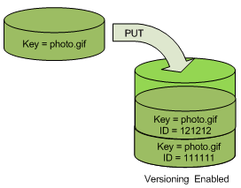
Amazon S3 - Versioning
Versioning is a means of keeping multiple variants of an object in the same bucket. You can use versioning to preserve, retrieve, and restore every version of every object stored in your Amazon S3 bucket.
Preserve, retrieve and restore every version
of every object in your bucket.
S3 automatically add new versions and preserve
deleted objects with delete markers.
Easy to tern on in AWS management console.

Slide 9
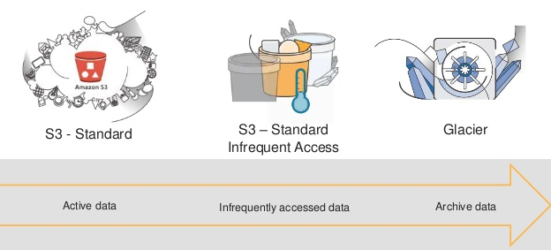
Amazon S3 – Storage Classes
Amazon S3 offers the following storage classes for the objects that you store. You choose
one depending on your use case scenario and performance access requirements. All of these storage classes offer high durability.

Slide 10
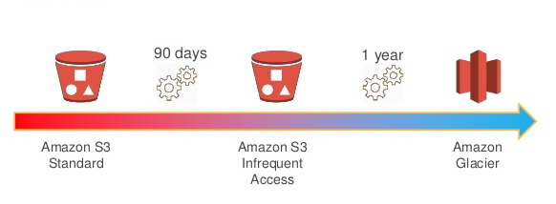
Amazon S3 – Lifecycle Management
Lifecycle configuration enables you to specify the lifecycle management of objects in a bucket. The configuration is a set of one or more rules, where each rule defines an action for Amazon S3 to apply to a group of objects. These actions can be classified as follows:
Transition Action
Expiration Action

Slide 11
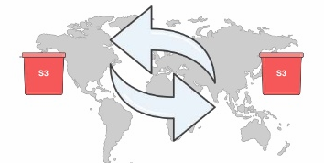
Amazon S3 – Cross Region Replication
Cross-region replication is a bucket-level configuration that enables automatic, asynchronous copying of objects across buckets in different AWS Regions. We refer to these buckets as source bucket and destination bucket.

Slide 12


Slide 13


